Slide 1
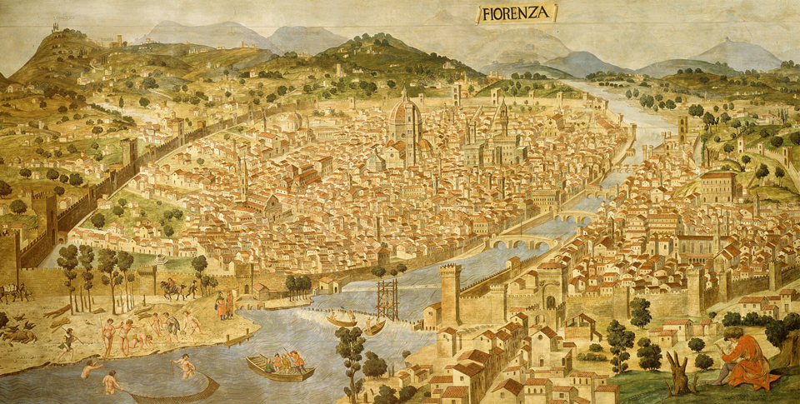
The Renaissance and Reformation (1300–1650)
Lesson 1 The Italian Renaissance

Slide 2
The Renaissance and Reformation (1300–1650)
Topic 4 Lesson 1 The Italian Renaissance
Learning Objectives
Describe the characteristics of the Renaissance and understand why it began in Italy.
Identify Renaissance artists and explain how new ideas affected the arts of the period.
Understand how writers of the time addressed Renaissance themes.
Explain the impact of the Renaissance.

Slide 3
The Italian Renaissance
A New Worldview
Ren thinkers did not break with European past but now brought new attitudes toward culture and learning
Ren ideal was a person with many talents and skills in diff fields
A Spirit of Adventure and Curiosity
The Ren lead people to explore new worlds or reexamine old ones. Christopher Columbus is one of these adventurers
Renaissance Humanism
Humanist scholars studied classical Greek and Latin cultures in order to learn about their own times
Humanist believe that education should stimulate the individual’s creative powers
Petrarch (1300’s) lived in Florence and he hunted down Greek and Roman manuscripts like Homer, Virgil, Cicero from monasteries and churches

Slide 4
The Italian Renaissance
The growth of urban areas helped spur and encourage a renewal of culture known as the Renaissance. This 19th century reconstruction of a 15th century painting shows Florence, Italy, in 1490.

Slide 5
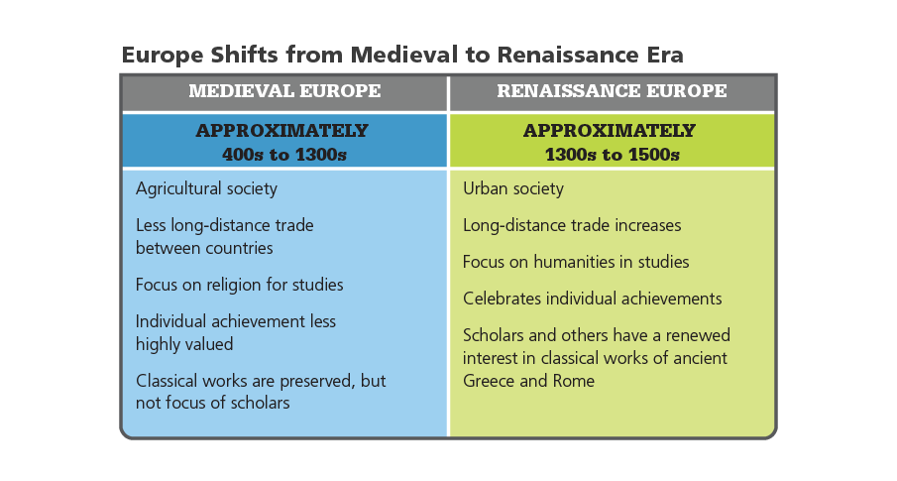
The Italian Renaissance
Analyze Charts Read the chart comparing medieval and Renaissance Europe. How were the achievements of individuals judged in the different eras?

Slide 6
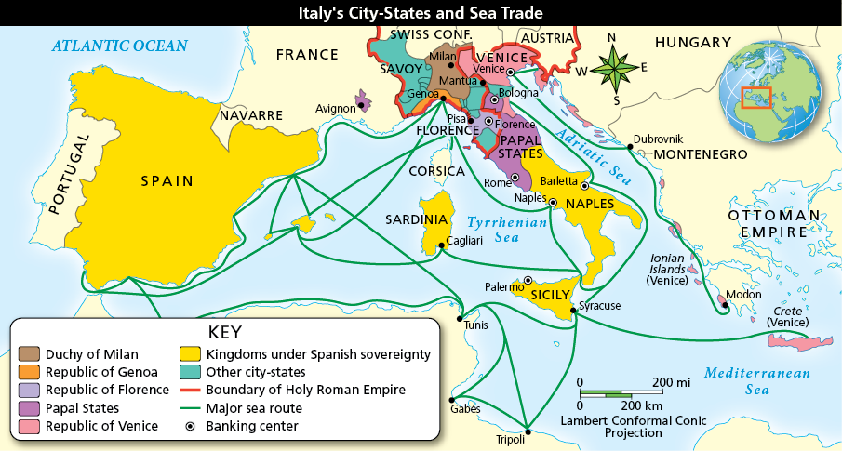
The Renaissance Begins in Italy
Analyze Maps The states and kingdoms of Italy lay at the center of Europe’s sea trade. Why were so many banking centers located in Italy?

Slide 7
The Renaissance Begins in Italy
Italy’s History and Geography
Italy’s historical artifacts was a constant reminder of the past
Italian cities thrived during the Middle Ages, ports did as well
Wealthy and powerful merchants promoted the Ren. They supported the arts
Florence and the Medicis
Florence was a wealthy Italian city state that produced a number of poets, architects, artists, scholars, and scientists.
1400’s the Medici’s organized a banking business. They became successful and in 1434 gained control of the city
Lorenzo “The Magnificent” Medici was the Ren ideal.
He was a clever politician, helping Florence through difficult times and was a generous patron of the arts

Slide 8
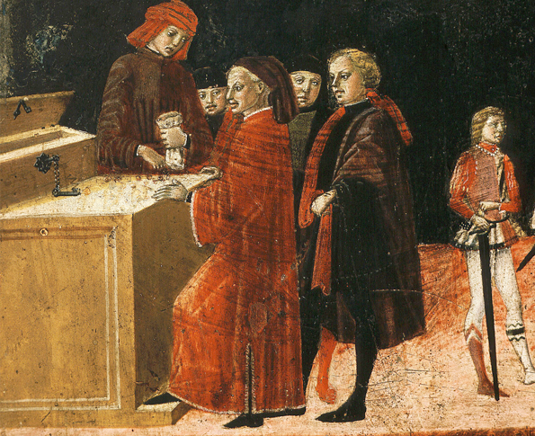
The Renaissance Begins in Italy
Analyze Information This painting from the 1400s depicts a typical scene in an Italian banking house. How is the wealth of the banker shown in this image?

Slide 9
The Renaissance Begins in Italy
Analyze Charts Review the chart about the Medici family in Renaissance Italy. During Lorenzo’s rule of Florence, in which years did he probably have more money to spend on the arts?

Slide 10
Art Flourishes in the Renaissance
Art Reflects New Ideas and Attitudes
Ren artists drew religious figures, well known figures of the day, scenes from Greek and Roman mythology, and depicted historical events
Donatello creates the first life-style statue of a soldier on horseback since ancient times.
New Techniques and Styles
Ren artists return back to Roman realist art when they draw
They discover perspective allowing them to show 3D on 2D surfaces
They also study anatomy and drew live models making their art appear more lifelike

Slide 11
Art Flourishes in the Renaissance
Renaissance Architecture
Rejected Gothic architecture, instead went back to columns, arches, and domes from the Ancient Greeks
Brunelleschi created a dome for his cathedral, using his talents as an engineer to create the equipment needed to make it
Leonardo da Vinci
Born in 1452, considered the most brilliant artist of the age
His masterpieces include the Mona Lisa and the Last Supper
Even though he was an artists, his interests ran into botany, anatomy, optics, music, architecture, and engineering.
He sketched flying machines and undersea boats centuries before the first planes and submarines

Slide 12
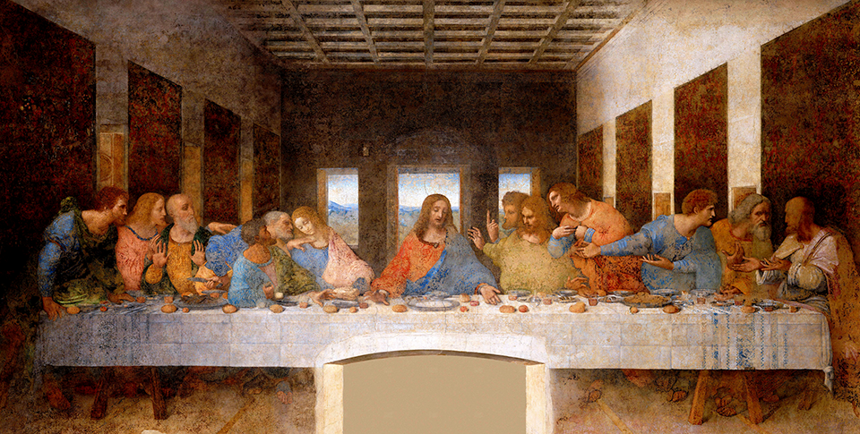

Slide 13
Art Flourishes in the Renaissance
Michelangelo
Born in 1475, he was a sculptor, engineer, painter, architect, and poet.
He creates the statue of David which was very similar to Greek sculptors
In 1508 he starts to paint on the ceiling of the Sistine Chapel. It takes 4 years
He designs the dome in St. Peter’s Cathedral in Rome
Raphael
Younger than Leonardo and Michelangelo he studies the work of those great artists
His art blends Christian and Classical styles
His painting School of Athens had many famous ancient scholars and a few Ren ones

Slide 14
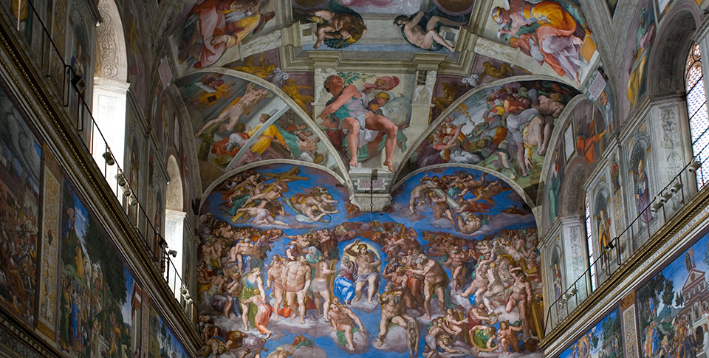

Slide 15
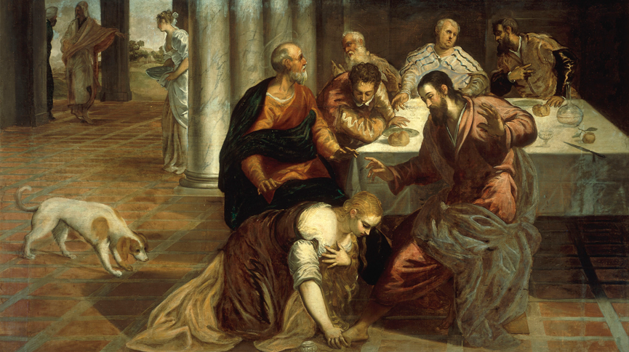
Art Flourishes in the Renaissance
In this painting by Italian Renaissance artist Tintoretto, Mary Magdalene anoints the feet of Jesus. Classical columns in the background reflect the Renaissance style.

Slide 16
New Books Reflect Renaissance Themes
Castiglione’s Ideal Courtier
Baldassare Castiglione wrote The Ideal Courtier to show the manners, skills, learning, and virtues a courtier should know
Machiavelli’s Advice to Princes
Niccolo Machiavelli was a diplomat who observed many kings and princes in foreign courts and studied Ancient Rome
In 1513 he writes The Prince as a guide for rulers to gain and maintain power
He stressed that the ends justified the means, urging rulers to do whatever necessary to achieve their goals
Critics attacked his advice (Machiavellian refers to lying in politics)
His work continues to spark debate because it raises important ethical questions about government and the use of power

Slide 17
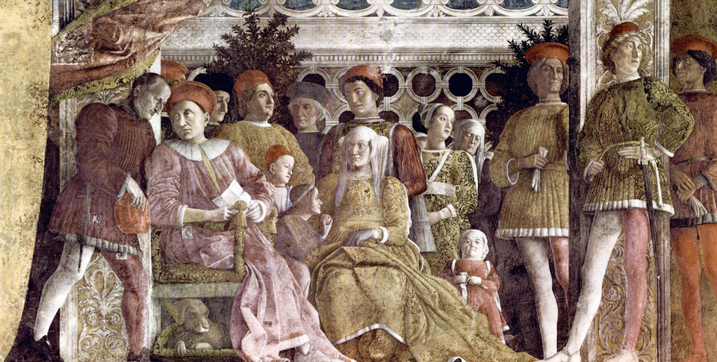
New Books Reflect Renaissance Themes
This 1474 painting by Italian Renaissance artist Andrea Mantegna is called The Court of Mantua. An Italian nobleman was Mantegna’s patron and commissioned art works like this.

Slide 18
Quiz: The Italian Renaissance
How did Renaissance humanists differ from medieval thinkers?
A. They focused solely on religious subjects and emphasized individual achievements.
B. They rejected the classical works from Greece and Rome, focusing their work on Biblical studies.
C. They were interested in inquiry and exploration, as well as the idea that humans could perfect themselves.
D. They looked to the classical works from Greece and Rome, focusing on a narrow, specialized area of study.

Slide 19
Quiz: The Renaissance Begins in Italy
What was one economic effect of the Renaissance?
A. Increased trade led to thriving Italian banks.
B. The Roman Catholic Church gave money to artists.
C. Wealthy Italian merchants invested in improving Muslim port cities.
D. Wealthy families like the Medicis purchased ancient treasures of Athens.

Slide 20
Quiz: Art Flourishes in the Renaissance
What style influenced the work of the architect Filippo Brunelleschi?
A. A Gothic style that created orderly buildings.
B. Classical forms from ancient Greece and Rome.
C. Medieval designs that emphasized religious themes.
D. A blend of Gothic and Medieval styles that created uniform buildings.

Slide 21
Quiz: New Books Reflect Renaissance Themes
What was a political impact of Machiavelli’s book, The Prince?
A. It gave courtiers political and social ideals to follow.
B. It made people reconsider views of government and political power.
C. It encouraged citizens in Italy to oppose corruption and oppression.
D. It led to the formation of a new government in Italy.

